Slide 1
RESTful Web Services

Slide 2
RESTful Web Services
REST stands for Representational State Transfer
More than a decade after its introduction, REST has become one of the most important technologies for Web applications.
Every major development language now includes frameworks for building RESTful Web services.

Slide 3
RESTful Web Services
It is primarily used to build Web services that are
lightweight
maintainable
scalable
A service based on REST is called a RESTful service.
REST is not dependent on any protocol, but almost every RESTful service uses HTTP as its underlying protocol.

Slide 4
Features of RESTful Web Services
Every system uses resources.
These resources can be pictures, video files, Web pages, business information, or anything that can be represented in a computer-based system.
The purpose of a service is to provide a window to its clients so that they can access these resources.

Slide 5
Features of RESTful Web Services
RESTful services should have following properties and features:
Representations
Messages
URIs
Uniform interface
Stateless
Links between resources
Caching

Slide 6
Representations
The focus of a RESTful service is on resources and how to provide access to these resources.
A resource can easily be thought of as an object as in OOP. A resource can consist of other resources.

Slide 7
Representations
While designing a system, the first step is to identify the resources and determine how they are related to each other. This is similar to the first step of designing a database: Identify entities and relations.
Second step: find a way to represent these resources. You can use any format for representing the resources, as REST does not put a restriction on the format of a representation.
Notes:
Depending on the requirements of the system, you can decide to use JSON or XML. If you are building Web services that will be used by Web pages for AJAX calls, then JSON is a good choice.
XML can be used to represent more complex resources.
In fact, you can use more than one format and decide which one to use for a response depending on the type of client or some request parameters.

Slide 8
Representations
{
"ID": "1",
"Name": ”Jessica Miller",
"Email": ”j.miller@gmail.com",
"Country": ”USA"
}
<Person>
<ID>1</ID>
<Name>Jessica Miller</Name>
<Email>j.miller@gmail.com</Email>
<Country>USA</Country>
</Person>
Notes:
Depending on the requirements of the system, you can decide to use JSON or XML. If you are building Web services that will be used by Web pages for AJAX calls, then JSON is a good choice.
XML can be used to represent more complex resources.
In fact, you can use more than one format and decide which one to use for a response depending on the type of client or some request parameters.

Slide 9
Representations
Whichever format you use, a good representation should have some obvious qualities:
Both client and server should be able to comprehend this format of representation.
A representation should be able to completely represent a resource.
The representation should be capable of linking resources to each other.

Slide 10
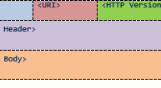
Messages
The client and service talk to each other via messages. Clients send a request to the server, and the server replies with a response.
HTTP Request Format

Slide 11
HTTP Request
<VERB> is one of the HTTP methods like GET, PUT, POST, DELETE, OPTIONS, etc
<URI> is the URI of the resource on which the operation is going to be performed
<HTTP Version> is the version of HTTP, generally "HTTP v1.1" .
<Request Header> contains the metadata as a collection of key-value pairs of headers and their values.
<Request Body> is the actual message content. In a RESTful service, that's where the representations of resources sit in a message.
Notes:
These settings contain information about the message and its sender like client type, the formats client supports, format type of the message body, cache settings for the response, and a lot more information.

Slide 12
HTTP Request
POST http://MyService/Person/
Host: MyService
Content-Type: text/xml; charset=utf-8
Content-Length: 123
<?xml version="1.0" encoding="utf-8"?>
<Person>
<ID>1</ID>
<Name>Jennifer Miller</Name>
<Email>j.miller@gmail.com</Email>
<Country>USA</Country>
</Person>
A sample POST request
Notes:
You can see the POST command, which is followed by the URI and the HTTP version. This request also contains some request headers. Host is the address of the server. Content-Type tells about the type of contents in the message body. Content-Length is the length of the data in message body. Content-Length can be used to verify that the entire message body has been received. Notice there are no start or end tags in this message.

Slide 13
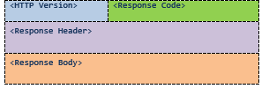
HTTP Response
Notes:
<Response Header> contains the metadata and settings about the response message.
<Response Body> contains the representation if the request was successful.

Slide 14
HTTP Response
HTTP/1.1 200 OK
Date: Sat, 23 Aug 2014 18:31:04 GMT
Server: Apache/2
Last-Modified: Wed, 01 Sep 2004 13:24:52 GMT
Accept-Ranges: bytes
Content-Length: 32859
Cache-Control: max-age=21600, must-revalidate
Expires: Sun, 24 Aug 2014 00:31:04 GMT
Content-Type: text/html; charset=iso-8859-1
<!DOCTYPE html PUBLIC "-//W3C//DTD XHTML 1.0 Strict//EN" "http://www.w3.org/TR/xhtml1/DTD/xhtml1-strict.dtd">
<html xmlns='http://www.w3.org/1999/xhtml'>
<head><title>Hypertext Transfer Protocol -- HTTP/1.1</title></head>
<body>
...
An actual response to a GET request
Notes:
The response code 200 OK means that everything went well and the response message body contains a valid representation of the resource I requested.

Slide 15
Addressing Resources
REST requires each resource to have at least one URI. A RESTful service uses a directory hierarchy like human readable URIs to address its resources.
Suppose we have a database of persons and we wish to expose it to the outer world through a service. A resource person can be addressed like this:
http://MyService/Persons/1
This URL has following format:
Protocol://ServiceName/ResourceType/ResourceID
Notes:
The job of a URI is to identify a resource or a collection of resources. The actual operation is determined by an HTTP verb. The URI should not say anything about the operation or action. This enables us to call the same URI with different HTTP verbs to perform different operations.

Slide 16
Addresssing Resources
Some important recommendations for well-structured URIs:
Use plural nouns for naming your resources.
Avoid using spaces as they create confusion
A URI is case insensitive.
You can have your own conventions, but stay consistent throughout the service.
Avoid verbs for your resource names. Verbs are more suitable for the names of operations. For example, a RESTful service should not have the URIs http://MyService/FetcthPerson/1 or http://MyService/DeletePerson?id=1.

Slide 17
Query Parameters
The basic purpose of query parameters is to provide parameters to an operation that needs the data items. For example, if you want the format of the presentation to be decided by the client. You can achieve that through a parameter like this:
http://MyService/Persons/1?format=xml&encoding=UTF8
or
http://MyService/Persons/1?format=json&encoding=UTF8

Slide 18
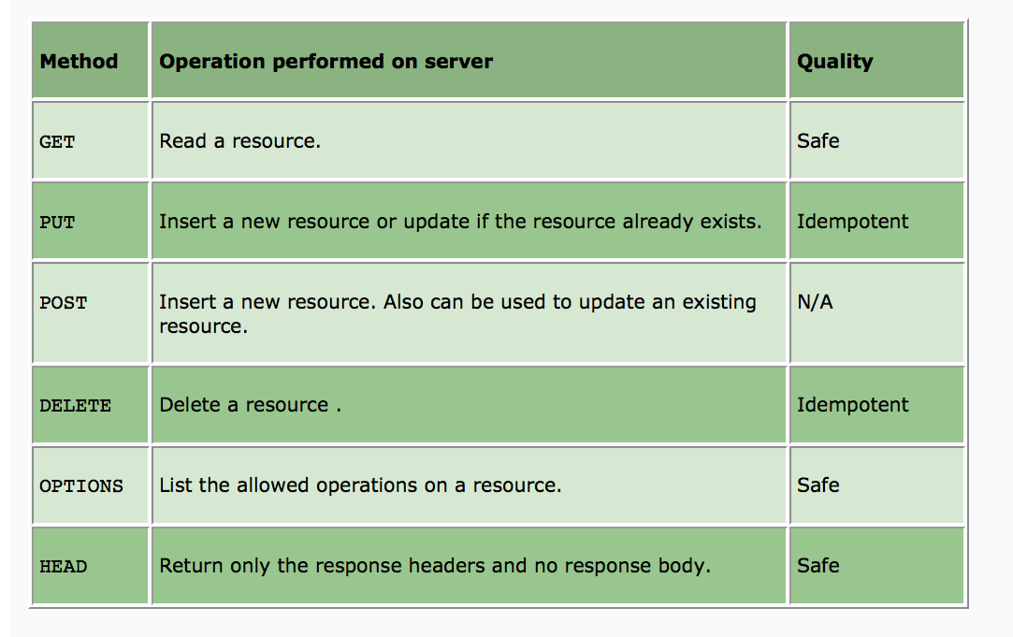
Methods
Method
Operation performed on server
Quality
GET
Read a resource.
Safe
PUT
Insert a new resource or update if the resource already exists.
Idempotent
POST
Insert a new resource. Also can be used to update an existing resource.
N/A
DELETE
Delete a resource .
Idempotent
OPTIONS
List the allowed operations on a resource.
Safe
HEAD
Return only the response headers and no response body.
Safe
Notes:
Methods that are provided by HTTP 1.1
A Safe operation is an operation that does not have any effect on the original value of the resource. For example, the mathematical operation "divide by 1" is a safe operation because no matter how many times you divide a number by 1, the original value will not change. An Idempotent operation is an operation that gives the same result no matter how many times you perform it. For example, the mathematical operation "multiply by zero" is idempotent because no matter how many times you multiply a number by zero, the result is always same. Similarly, a Safe HTTP method does not make any changes to the resource on the server. An Idempotent HTTP method has same effect no matter how many times it is performed.
Idempotent: Describing an action which, when performed multiple times, has no further effect on its subject after the first time it is performed.

Slide 19
Methods
GET is probably the most popular method on the Web. It is used to fetch a resource.
HEAD returns only the response headers with an empty body. This method can be used in a scenario when you do not need the entire representation of the resource. For example, HEAD can be used to quickly check whether a resource exists on the server or not.

Slide 20
Methods
The method OPTIONS is used to get a list of allowed operations on the resource. Consider following request:
OPTIONS http://MyService/Persons/1 HTTP/1.1
HOST: MyService
The service after authorizing and authenticating the request can return something like:
200 OK
Allow: HEAD, GET, PUT
The second line contains the list of operations that are allowed for this client.

Slide 21
Methods
You should use these methods only for the purpose for which they are intended. For instance, never use GET to create or delete a resource on the server.
GET http://MyService/DeletePersons/1 HTTP/1.1
HOST: MyService
DELETE http://MyService/Persons/1 HTTP/1.1
HOST: MyService

Slide 22
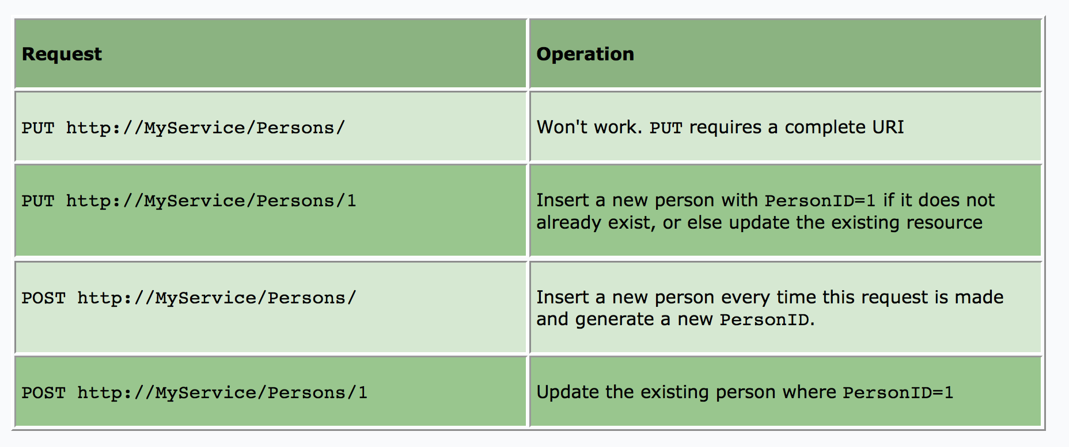
Difference between PUT and POST
Notes:
It is clear from the above table that a PUT request will not modify or create more than one resource no matter how many times it is fired (if the URI is same). There is no difference between PUT and POST if the resource already exists, both update the existing resource. The third request (POST http://MyService/Persons/) will create a resource each time it is fired. A lot of developers think that REST does not allow POST to be used for update operation; however, REST imposes no such restrictions.

Slide 23
Statelessness
A RESTful service is stateless and does not maintain the application state for any client. A request cannot be dependent on a past request and a service treats each request independently.

Slide 24
Links between resources
A resource representation can contain links to other resources like an HTML page contains links to other pages. The representations returned by the service should drive the process flow as in case of a website.

Slide 25
Links between resources
Let's consider the case in which a client requests one resource that contains multiple other resources. Instead of dumping all these resources, you can list the resources and provide links to them. Links help keep the representations small in size.

Slide 26
Links between resources
For an example, if multiple Persons can be part of a Club, then a Club can be represented in MyService as follows:
<Club>
<Name>Authors Club</Name>
<Persons>
<Person>
<Name>M. Vaqqas</Name>
<URI>http://MyService/Persons/1</URI>
</Person>
<Person>
<Name>S. Allamaraju</Name>
<URI>http://MyService/Persons/12</URI>
</Person>
</Persons>
</Club>

Slide 27
Caching
Caching is the concept of storing the generated results and using the stored results instead of generating them repeatedly if the same request arrives in the near future. This can be done on the client, the server, or on any other component between them, such as a proxy server.

Slide 28
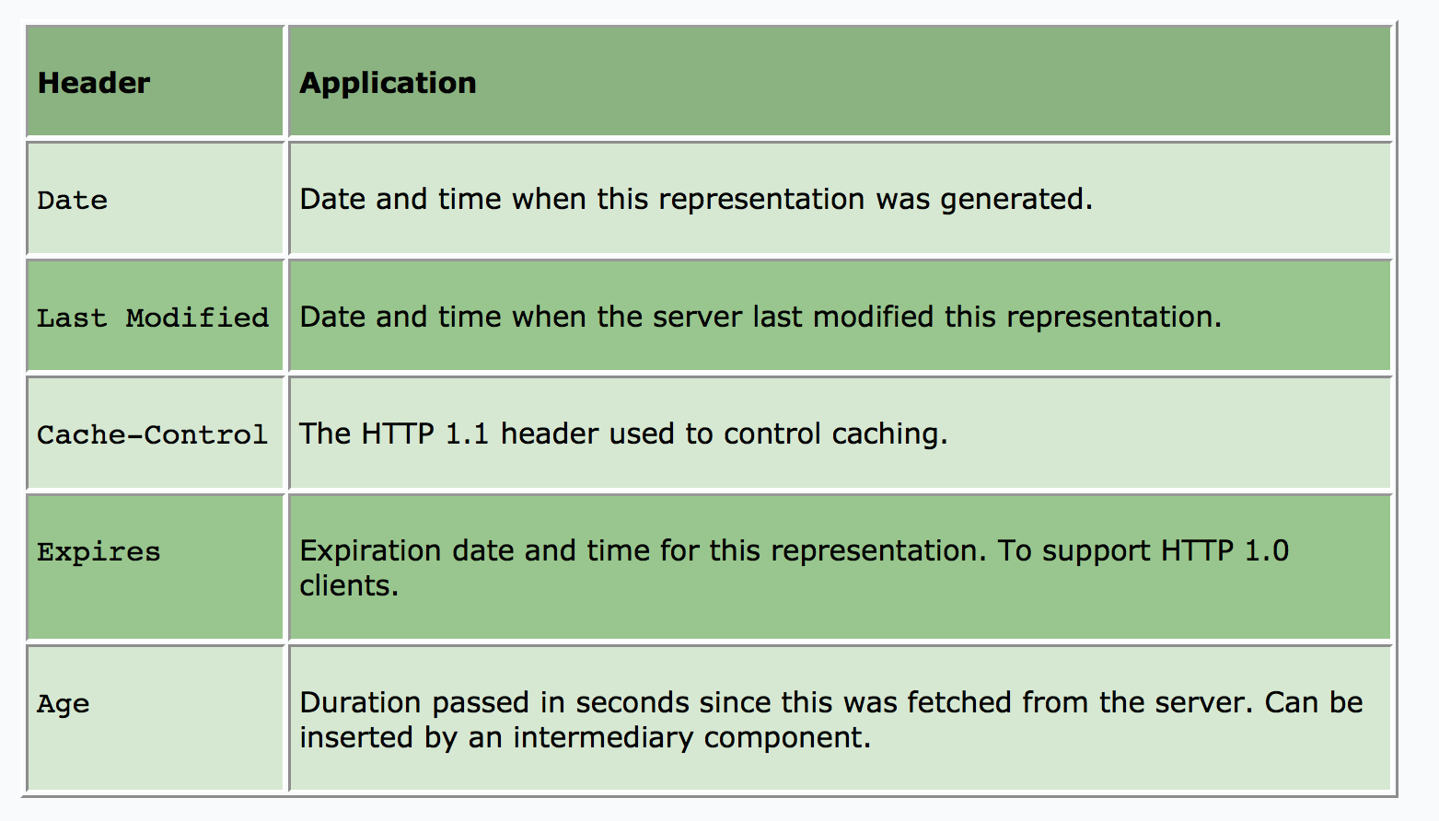
Caching
Caching can be controlled using HTTP headers:

Slide 29
Resources
http://en.wikipedia.org/wiki/Representational_state_transfer
http://www.drdobbs.com/web-development/restful-web-services-a-tutorial/240169069
http://rest.elkstein.org/2008/02/what-is-rest.html
http://www.ibm.com/developerworks/library/ws-restful/

Slide 30
SOAP vs. REST
https://www.youtube.com/watch?v=v3OMEAU_4HI

